Slide 1
Organ Transplant Analysis

Slide 2
Introduction
https://www.wsj.com/articles/SB118901049137818211

Slide 3
Introduction
blood type
tissue type
height and weight of transplant candidate
size of donated organ
medical urgency
time on the waiting list
the distance between the donor's hospital and the potential donor organ
https://optn.transplant.hrsa.gov/learn/about-transplantation/transplant-process/

Slide 4
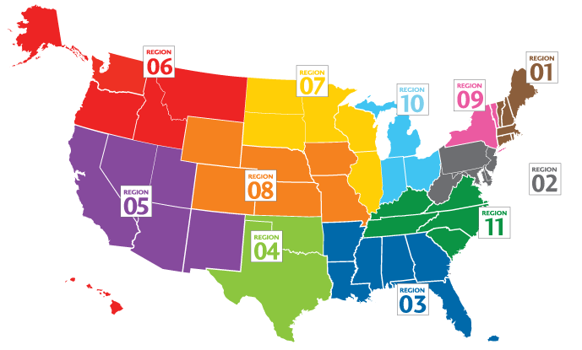
Introduction
https://unos.org/community/regions/

Slide 5
The average time frame for waiting can be 3-5 years at most centers and even longer in some geographical regions.
https://www.kidney.org/atoz/content/transplant-waitlist

Slide 6
Disclaimer
“The data reported here have been supplied by the United Network for Organ Sharing (UNOS) as the contractor for the Organ Procurement and Transplantation Network (OPTN). The interpretation and reporting of these data are the responsibility of the author(s) and in no way should be seen as an official policy of or interpretation by the OPTN or the U.S. Government.”
This research was performed based on OPTN data as of July 15, 2021.

Slide 7
Exploratory Data Analysis
Steady rise in organ waitlist registration
2020 drop (COVID?)

Slide 8
Regional Difference
DE : 0.287
CA : 0.338
OH : 0.525
NE : 0.630
Note the number of people!
Notes:
DE : Delaware
NE : Nebraska

Slide 9
Feature Selections
Antibody testing
Gender
Blood type
Diabetes
Initial BMI
Initial height
Initial weight
Initial age
State
State ratio
Survival rate
Number of transplants
Distance
Diagnosis

Slide 10
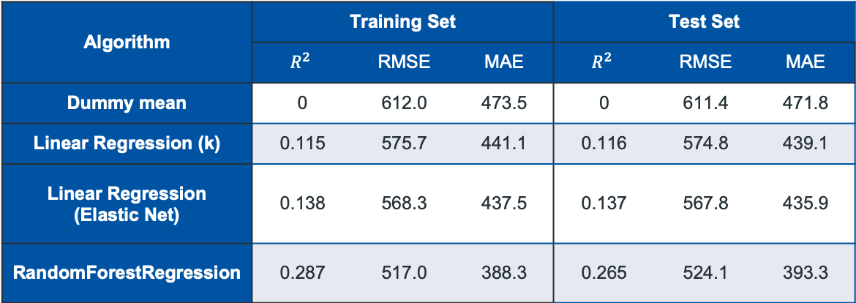
Model Selection
Algorithm | Training Set |  |  | Test Set
 | $$R^{2}$$ | RMSE | MAE | $$R^{2}$$ | RMSE | MAE
Dummy mean | 0 | 612.0 | 473.5 | 0 | 611.4 | 471.8
Linear Regression (k) | 0.115 | 575.7 | 441.1 | 0.116 | 574.8 | 439.1
Linear Regression (Elastic Net) | 0.138 | 568.3 | 437.5 | 0.137 | 567.8 | 435.9
RandomForestRegression | 0.287 | 517.0 | 388.3 | 0.265 | 524.1 | 393.3

Slide 11
Problems
Long runtime
Poor accuracy
No cosumability
Notes:
– Error about one year long
– Each gridsearch takes > 2 hours

Slide 12
Survival rate
Initial age
Distance

Slide 13
Future Direction
Cutting Data Certain Time Frame from Recent
Continue Tuning Hyperparameters
1
3
2
4
Analyze Data by Year
Convert to Classification Problem

Slide 14
Future Directions
Continue Tuning Hyperparameters
Analyze Data by Year
1
2
Cutting Data Certain Time Frame from Recent
Convert to Classification Problem
3
4

Slide 15
Thanks!
Any questions?
Dae Hyun Kim
Email: drmhk1511@gmail.com
https://www.linkedin.com/in/daehykim/
https://github.com/DaeHyun-K/Second-Capstone

